Slide 1
BFX AT-100 U801_RTL8211F-CG material issue report
Prepare by: PE – JUSTIN
Update Date: 2025/03/25

Slide 2
FA TEAM
Fii | ALT OTT
Team Leader: PE Leader: Jack Han TE Leader: Mark QA: Toney Tu Team Members: TE: Allan ME: Wen-tai PE: Michael Ruan/ Justin QA: Ken/ Rachel PM: Roisy | Team Leader: QA: SH Son Team Members:

Slide 3
Problem Description
Issue Description (5W1H)
When | 2024-Dec-04
Who | SH Son
Where | ALT customer side
What | ALT customer return 1pc DOA T99X171.00 no boot issue
Why | U801_RTL8211F-CG (MPM: RTL8211F-CG, P/N 002.02152.005, DC: O15, Vendor: REALTEK) component.
How many | 1pcs DOA: can’t Boot
On 04-Dec, 2024, T99X171.00 model, ALT customer return 1pcs DOA issue: No boot issue
S/N range : 2149688001202404231426
Defect rate: 0.25% (1/388 pcs)

Slide 4

DOA analysis
Confirm fail symptom
Symptom: No boot
Sorting analysis:
Visual check → No found out abnormal.
Measurement → No found out abnormal
Boot Up Fail
Impedance & VF voltage Units
Location | Description | OK sample |  | #NG
 |  | Impedance | VF | Impedance | VF
R328 | PP_PWR_IN | 3.260K | 0.504 | 3.123K | 0.511
L303 | P1V2 | 182 | 0.089 | 135.9 | 0.081
R325 | P2V5 | 21.61K | 0.392 | 16.35K | 0.324
L304 | P3V3 | 19.59K | 0.35 | 19.59K | 0.35
C322 | eMMC_VDDQ | 23.14K | 0.416 | 22.8K | 0.418
L301 | VDDCPU | 66.1 | 0.075 | 64.3 | 0.073
L302 | VDD_EE | 35.5 | 0.037 | 33.4 | 0.035
L801 | ETH_DVDD10 | 1.952K | 0.299 | 1.886K | 0.283
Summary:
NG board no boot with out impedance normal

Slide 5





Production History Data Checking
T Level data (SMT)
SN | Test Station
Y0R0Z56 | SMTLOADING | TURNPCB | SPI2 | AOI_2 | INSP | PCB_STOCKIN
 | 24/07/04 10:16 PM | 24/07/05 5:12 PM | 24/07/05 7:30 PM | 24/07/05 8:05 PM | 24/07/05 8:17 PM | 24/07/09 12:50 PM
Dot Level data (FATP )
S/N range | Test Station
2149688001202404231426 | UK | FT | FT1 | RC | RC1 | RC2
 | 24/07/10 2:22 AM | 24/07/10 2:28 AM | 24/07/10 2:37 AM | 24/07/10 2:58 AM | 24/07/10 3:19 AM | 24/07/10 3:25 AM
Test logs | UK test haven’t logs test
Summary:
- This unit has PASSED normally SMT and FATP.
- Shipping date: 2024/07/15 16:17:18

Slide 6
Re-Test at FATP
Re-Test UK and FATP to verify result:
STATION | UK | FT | FT1 | RC | RC1 | OBA | RC2
Result | PASS | FAIL (PRODUCT CAN NOT PING) | FAIL | FAIL | FAIL | FAIL | FAIL
Summary :
Re-download FW, NG board can boot normal
Re-test FT ➔ NG board no ping 192.168.100.25

Slide 7
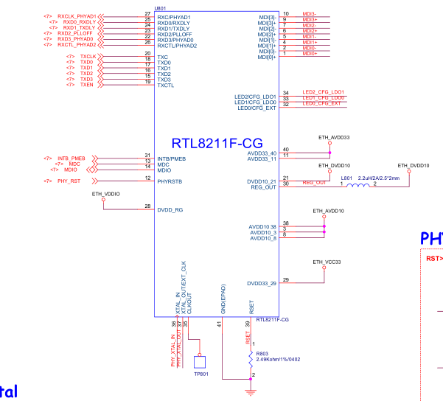
No ping Analysis
Measure RTL8211F-CG IC (IC ping) result:
Voltage(V)
No# | Pin | OK sample | #NG
1 | MDIP0 | 1.637 | 1.667
2 | MDIN0 | 1.632 | 1.668
3 | AVDD10 | 0.994 | 0.997
4 | MDIP1 | 1.640 | 1.653
5 | MDIN1 | 1.633 | 1.668
6 | MDIP2 | 1.639 | 1.667
7 | MDIN2 | 1.632 | 1.665
8 | AVDD10 | 0.994 | 0.997
9 | MDIP3 | 1.636 | 1.665
10 | MDIN3 | 1.631 | 1.667
11 | AVDD33 | 3.340 | 3.340
12 | PHYRSTB | 3.333 | 3.331
13 | MDC | 0 | 0
14 | MDIO | 1.794 | 1.792
15 | TXD3 | 0 | 0
16 | TXD2 | 0 | 0
17 | TXD1 | 0 | 0
18 | TXD0 | 0 | 0
19 | TXCLT | 0 | 0
20 | TXC | 0.921 | 0.901
Voltage(V)
No# | Pin | OK sample | #NG
21 | DVDD10 | 0.995 | 0.997
22 | RXD3/PHYAD0 | 0.008 | 0.007
23 | RXD2/PLLOFF | 0.008 | 0.007
24 | RXD1/TXDLY | 0.008 | 0.007
25 | RXD0/RXDLY | 0.001 | 0.001
26 | RXCTL/PHYAD2 | 0.001 | 0.001
27 | RXC/PHYAD1 | 0.894 | 0.893
28 | DVDD_RG | 1.795 | 1.974
29 | DVDD33 | 3.340 | 3.340
30 | REG_OUT/LDO_OUT | 0.999 | 1.0
31 | INTB/PMEB | 0.033 | 0.033
32 | LED0/CFG_EXT | 3.333 | 3.34
33 | LED1/CFG_LDO0 | 0 | 0
34 | LED2/CFG_LDO1 | 3.338 | 0
35 | CLKOUT | 1.844 | 0
36 | XTAL_IN | 0.862 | 0.843
37 | XTAL_OUT/EXT_CLK | 0.863 | 0.841
38 | AVDD10 | 0.994 | 0.996
39 | RSET | 0.620 | 0.619
40 | AVDD33 | 3.340 | 3.340
U801_ RTL8211F-CG schematic
Summary :
U801_RTL8211F-CG (MPM: RTL8211F-CG, P/N 002.02152.005, DC: O15, Vendor: REALTEK) have pin 34 LED/CFG_LDO1 and pin 35: CLKOUT voltage abnormal.

Slide 8
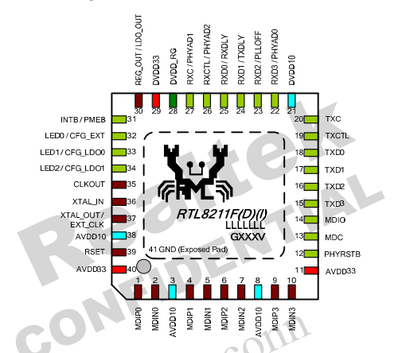
Measure U801_RTL8211F-CG analysis
Measure impedance: Remove NG U801 to measure impedance result as table below:
Impedance measure (Ohm)
No# | Pin | OK sample | #NG
1 | MDIP0 | 1.586M | 1.623M
2 | MDIN0 | 1.584M | 1.623M
3 | AVDD10 | 18.28K | 19.94K
4 | MDIP1 | 1.583M | 1.621M
5 | MDIN1 | 1.583M | 1.620M
6 | MDIP2 | 1.670M | 1.708M
7 | MDIN2 | 1.670M | 1.709M
8 | AVDD10 | 18.26K | 19.89K
9 | MDIP3 | 1.679M | 1,707M
10 | MDIN3 | 1.678M | 1.709M
11 | AVDD33 | 124.7K | 122.6K
12 | PHYRSTB | 0 | 0
13 | MDC | 0 | 0
14 | MDIO | 0 | 0
15 | TXD3 | 2.595M | 2.633M
16 | TXD2 | 2.589M | 2.630M
17 | TXD1 | 2.590M | 2.636M
18 | TXD0 | 2.586M | 2.636M
19 | TXCLT | 2.594M | 2.632M
20 | TXC | 2.591M | 2.637M
Impedance measure (Ohm)
No# | Pin | OK sample | #NG
21 | DVDD10 | 2.029K | 2.535K
22 | RXD3/PHYAD0 | 2.393M | 2.428M
23 | RXD2/PLLOFF | 2.395M | 2.451M
24 | RXD1/TXDLY | 2.404M | 2.434M
25 | RXD0/RXDLY | 2.409M | 2.447M
26 | RXCTL/PHYAD2 | 2.399M | 2.425M
27 | RXC/PHYAD1 | 2.392M | 2.436M
28 | DVDD_RG | 216.8K | 219.2K
29 | DVDD33 | 184.3K | 184.2K
30 | REG_OUT/LDO_OUT | 1.275M | 1.340M
31 | INTB/PMEB | 0 | 0
32 | LED0/CFG_EXT | 2.498M | 2.540M
33 | LED1/CFG_LDO0 | 2.498M | 2.539M
34 | LED2/CFG_LDO1 | 2.493M | 98.16k
35 | CLKOUT | 2.454M | 122.6k
36 | XTAL_IN | 2.515M | 2.566M
37 | XTAL_OUT/EXT_CLK | 2.908M | 2.971M
38 | AVDD10 | 83.1K | 99.1K
39 | RSET | 2.515M | 2.562M
40 | AVDD33 | 124.6K | 123.8K
U801_RTL8211F-CG datasheet
Summary: U801_RTL8211F-CG (MPM: RTL8211F-CG, P/N 002.02152.005, DC: O15, Vendor: REALTEK) have pin 34 LED/CFG_LDO1 and pin 35: CLKOUT low impedance abnormal.

Slide 9
Swap Component verification
Swap U801 verification between NG and OK material:
NG Board Items | Ping 192.168.100.25 result
OK board + OK U801 | Normal
NG board + NG U801 | Download UK OK, Can not Ping
OK board + NG U801 | Download UK OK, Can not Ping
NG board + OK U801 | Normal
Summary :
- This issue follow U801_RTL8211F-CG (MPM: RTL8211F-CG, P/N 002.02152.005, DC: O15, Vendor: REALTEK) component no work issue

Slide 10
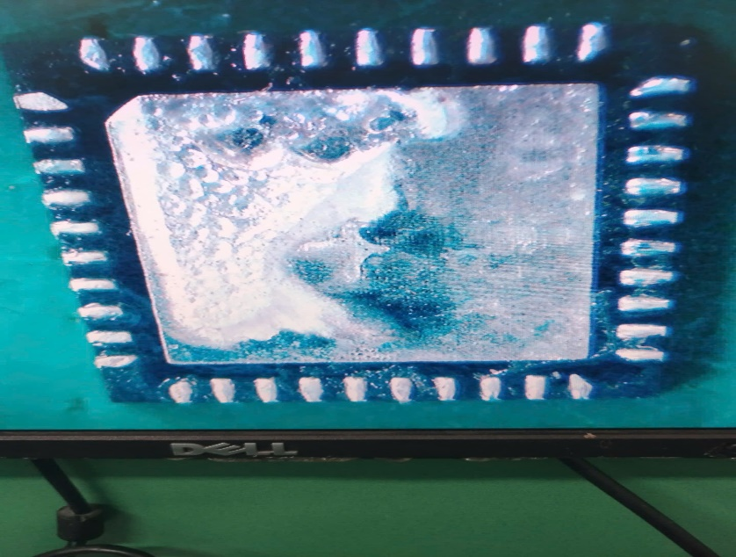
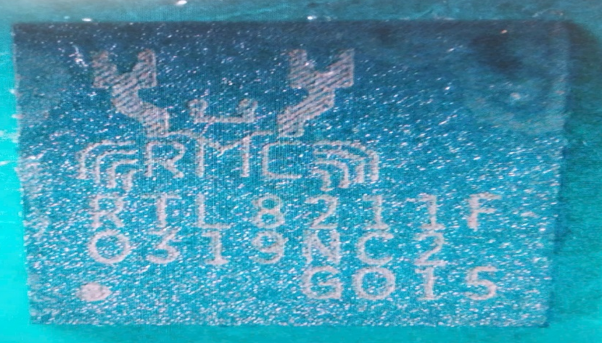
Visual inspection
Take picture of U801_RTL8211F-CG (MPM: RTL8211F-CG, P/N 002.02152.005, DC: O15, Vendor: REALTEK)
Side
 | BOT | TOP
#2149688001202404231426
#NG
Summary
- Visual inspection component U801_RTL8211F-CG (MPM: RTL8211F-CG, P/N 002.02152.005, DC: O15, Vendor: REALTEK)→ No found abnormality

Slide 11

Summary
Summary:
Product can’t boot up by can’t sync with U801_RTL8211F-CG IC at customer image
No ping issue can cover 100% by FATP
→ This issue follow U801_RTL8211F-CG (MPM: RTL8211F-CG, P/N 002.02152.005, DC: O15, Vendor: REALTEK) component no work
Action:
Check U801_RTL8211F-CG defect rate: PN: 002.02152.005, DC: O15
Total q’ty: 50610pcs, Used: 50610pcs, Remaining: 0pcs
DOA: 1/ 50610~ 18DPPM
Fii send FA report and NG component to SQE co-work with REALTEK vendor further FA report. Owner: SQE. Naomi. Due date: 2025/01/16
Result:
REALTEK vendor have sent FA report for NG material ➔ No found abnormal
Factory keep tracking this issue

